Slide 1
Introduction to Machine Learning Classification for Data Exploration module 9
Note to other teachers and users of these slides. Feel free to use or modify these slides as you wish. If you use a significant portion of these slides in your own lecture, please include this message, or the following link to the source repository of Michele’s lectures on github:
https://github.com/samorani. Comments and corrections are welcome.

Slide 2
This course
Visualization packages
Matplotlib /
Seaborn
TODAY
scikitlearn
Machine learning package
pandas
Data structures package
numpy
Computation package
Python
Language, syntax

Slide 3
Machine Learning
Set of techniques to find nontrivial patterns in one table. The main tasks are:
Classification: explain a categorical (usually binary) column given all other columns
Clustering: partition the rows into homogeneous groups
Regression: explain a numeric column given all other columns

Slide 4
Scikit-learn : ML in Python
scikit-learn is a Python module integrating classic machine learning algorithms in the tightly-knit world of scientific Python packages (numpy, scipy, matplotlib, statsmodel)
Tools for:
Classification
Clustering
Dimensionality Reduction
Model Selection
Regression (but if you are a statistician, you’d prefer statsmodel)

Slide 5
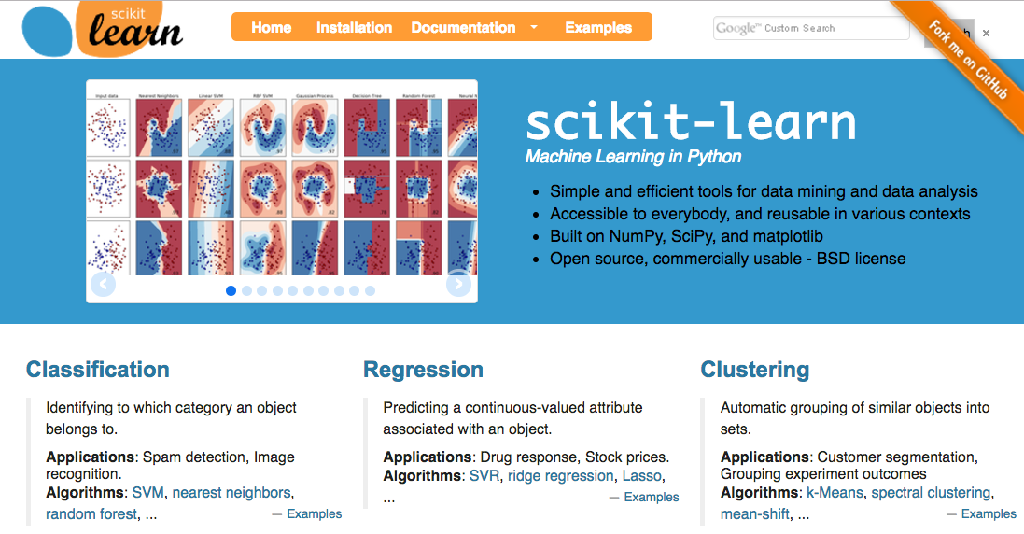
Scikit-learn : http://scikit-learn.org/

Slide 6
Classification
Goal: Explain or predict categorical target (outcome) variable
Examples: Purchase/no purchase, fraud/no fraud, creditworthy/not creditworthy…
Each row is a case (customer, student, applicant)
Each column is a variable
Target variable is often binary (0/1)

Slide 7
Classification for prediction
Some classifiers are interpretable
Decision trees
Logistic regression
Some aren’t
Support vector machines
Neural network
Classification Jargon:
Class: the target attribute that we want to predict
Training set: the table (DataFrame) used to learn
Classifier: the entity that learns the differences between classes
Fit/train: the task of learning
Predict: after training, the task of predicting the class of new objects
Class
1 | 0.5 | 0.4 | 0
Training set
Fit/Train
1.3 | 2.0 | 0.3 | 0
CLASSIFIER
CLASSIFIER
1.1 | 3.0 | 1.3 | 1
0.1 | 2.5 | 0.3 | 1
Predict
Test set
1
1.4 | 2.1 | 0.9 | ?

Slide 8
Fit and predict in classification
All models (Classification and regression) implement at least two methods:
fit(x, y) - Fit the model to the given dataset
predict(x) - Predict the y values associated with the x values

Slide 9
Classification for data exploration
Some classifiers are interpretable
Decision trees
Logistic regression
Some aren’t
Support vector machines
Neural network
The classifier must be interpretable
Decision trees
Logistic regression
Classification Jargon:
Class: the target attribute that we want to predict
Training set: the table (DataFrame) used to learn
Classifier: the entity that learns the differences between classes
Fit/train: the task of learning
Predict: after training, the task of predicting the class of new objects
Class
1 | 0.5 | 0.4 | 0
Training set
Fit/Train
1.3 | 2.0 | 0.3 | 0
CLASSIFIER
CLASSIFIER
1.1 | 3.0 | 1.3 | 1
0.1 | 2.5 | 0.3 | 1
Predict
Test phase
1
1.4 | 2.1 | 0.9 | ?

Slide 10
Classification for Data Exploration
Decision Trees

Slide 11
To visualize decision trees – Windows
Before we start, we need to install a couple of things which will make it possible to visualize decision trees.

Slide 12
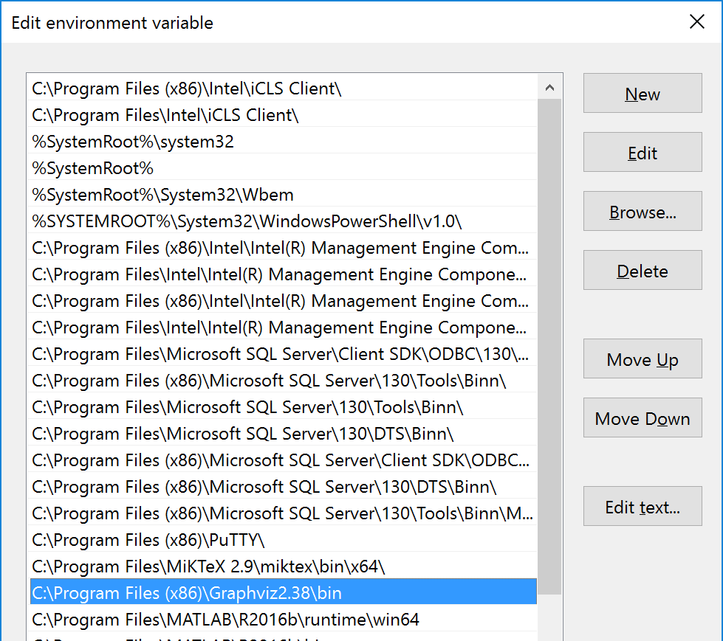
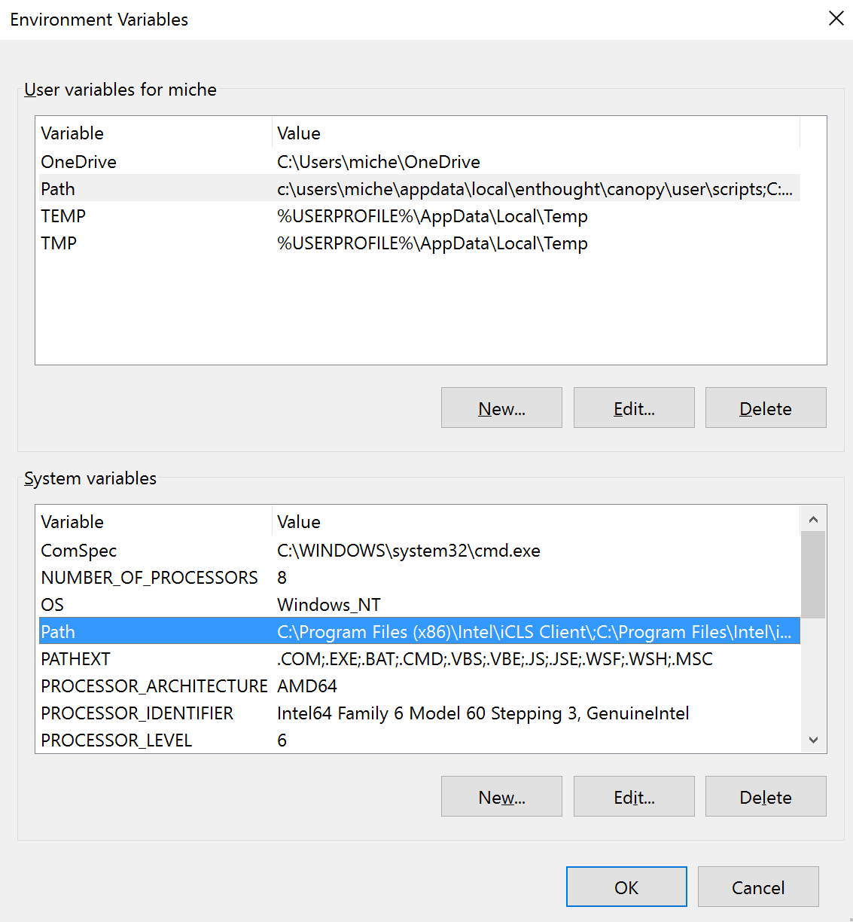
Windows
Download and install the msi file of grphicviz
Add the executables (e.g., C:\Program Files (x86)\Graphviz2.38\bin) to the path
Install pydotplus:
on terminal: pip install pydotplus
1
2

Slide 13
Macs
1. Open the Terminal
2. Run the following command and hit 'Enter'
xcode-select –install
3. Run the Xcode installer. Once the installation is complete run the following command to install brew.
ruby -e "$(curl -fsSL https://raw.githubusercontent.com/Homebrew/install/master/install)"
4. Run the following command once you're done to ensure Homebrew is installed and working
brew doctor
Enter the command below to install graphviz
brew install graphviz
Install pydotplus
pip install pydotplus

Slide 14
Decision Tree in a nutshell
GOAL: build a tree of decisions to predict the class of an object
Recursively partition the training set with the goal of minimizing classification errors, using the “most” helpful attribute
Many methods to choose the attribute for partitioning
Maximize information gain
Minimize gini impurity
Let’s see an example…

Slide 15
Example: Fountain owners
Goal: Classify 24 households as owning or not owning fountains
Attributes = Income, Lot Size

Slide 16
Income Lot size Ownership
59.9 17.4 owner
84.6 16.1 owner
64.3 21.3 owner
60.8 20.2 owner
86.9 22.8 owner
109.3 18.8 owner
107.1 17.3 owner
82.5 21.6 owner
68.9 19.8 owner
92 19.9 owner
50.4 21.8 owner
80.4 19.7 owner
74.9 19.5 non-owner
52.3 20 non-owner
64.6 16.6 non-owner
42.8 19.8 non-owner
83.3 17 non-owner
48.9 16.8 non-owner
58.6 15.7 non-owner
65.9 17.5 non-owner
47.2 15.9 non-owner
32.8 18.6 non-owner
50.9 13.6 non-owner
62.2 13.9 non-owner
We want to build a tree that tells us the difference between:
Owners: those who own a fountain
Non-owners: those who do not
Training set

Slide 17
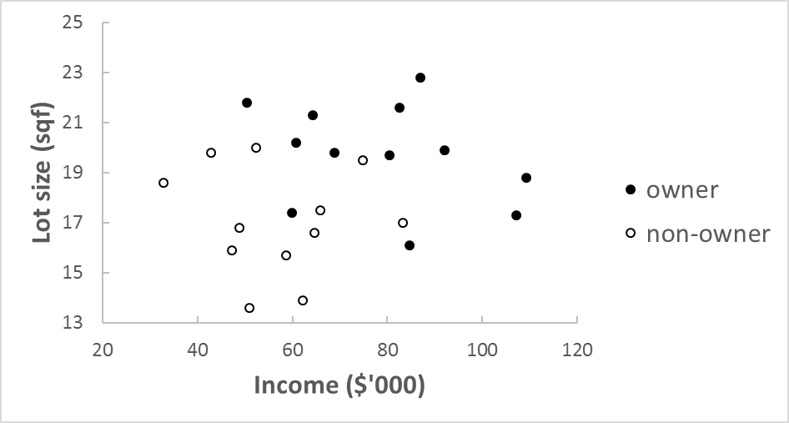
Here is the data set

Slide 18
First split
Decision tree of depth 1
Lot > 18.7?
False
True
nonowner
owner
Suppose that the one above is the final tree.
How many classification errors does this tree make on the training set?

Slide 19
First split
Decision tree of depth 1
Lot > 18.7?
False
True
nonowner
owner
Let’s split this node further

Slide 20
Second split
Decision tree of depth 1
Lot > 18.7?
False
True
Income > 84?
owner
False
True
nonowner
owner
Suppose that the one above is the final tree.
How many classification errors does this tree make on the training set?

Slide 21
Second split
Decision tree of depth 2
Lot > 18.7?
False
True
Income > 84?
owner
False
True
nonowner
owner
Let’s split this node further

Slide 22
Second split
Decision tree of depth 2
Lot > 18.7?
False
True
Income > 84?
Income > 58?
False
False
True
True
nonowner
owner
nonowner
owner
How many classification errors does this tree make on the training set?

Slide 23
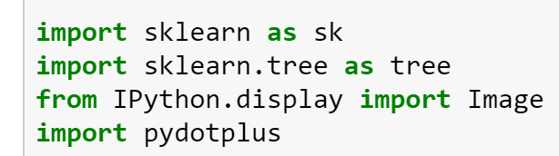

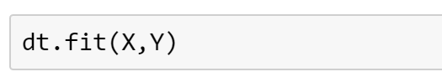
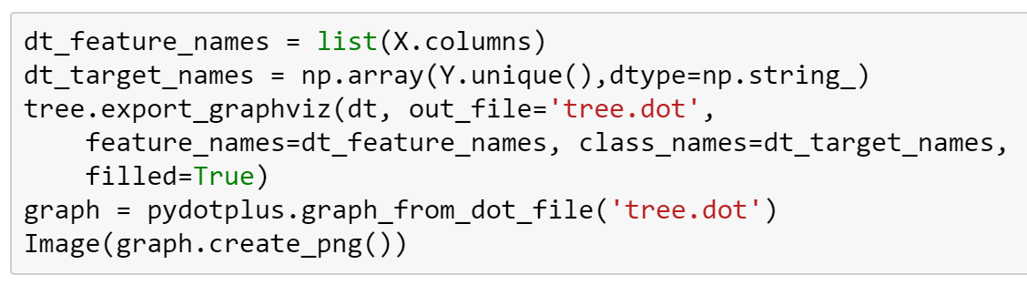
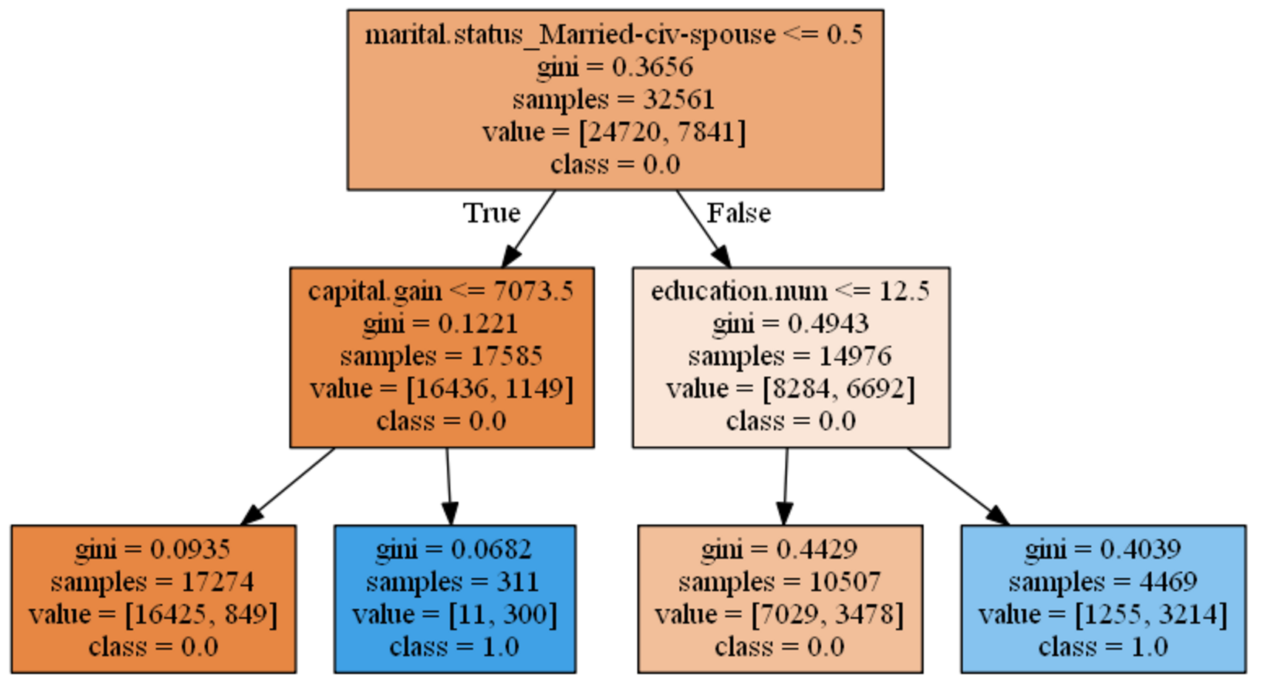
How to train a decision tree in scikit learn
For better interpretability, make your tree shallow
To view tree
X
Y
1 | 0.5 | 0.4 | 0
Fit/Train
1.3 | 2.0 | 0.3 | 0
1.1 | 3.0 | 1.3 | 1
DETAILS LATER
0.1 | 2.5 | 0.3 | 1

Slide 24
Predicting High Income
Case study similar to project

Slide 25
Today’s data set
https://www.kaggle.com/uciml/adult-census-income
This data was extracted from the 1994 Census bureau database by Ronny Kohavi and Barry Becker (Data Mining and Visualization, Silicon Graphics). The prediction task is to determine whether a person makes over $50K a year.

Slide 26
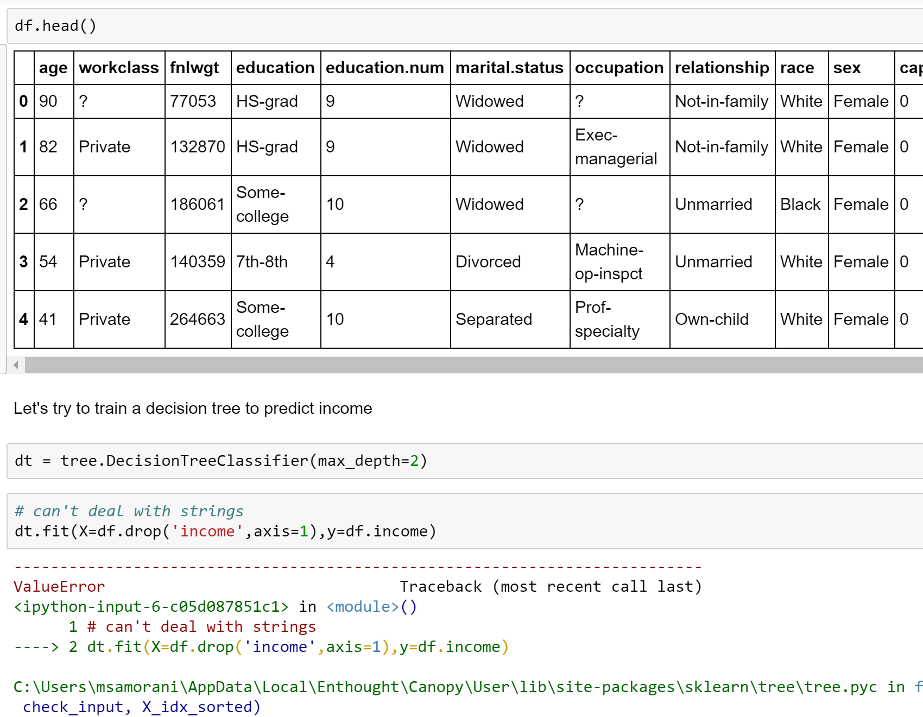
We need all numeric values
So, let’s clean up the data set

Slide 27
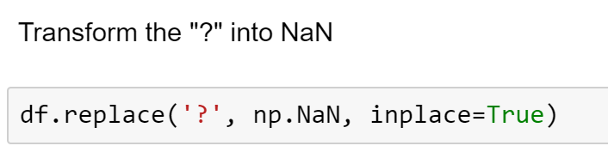
CLEANING

Slide 28
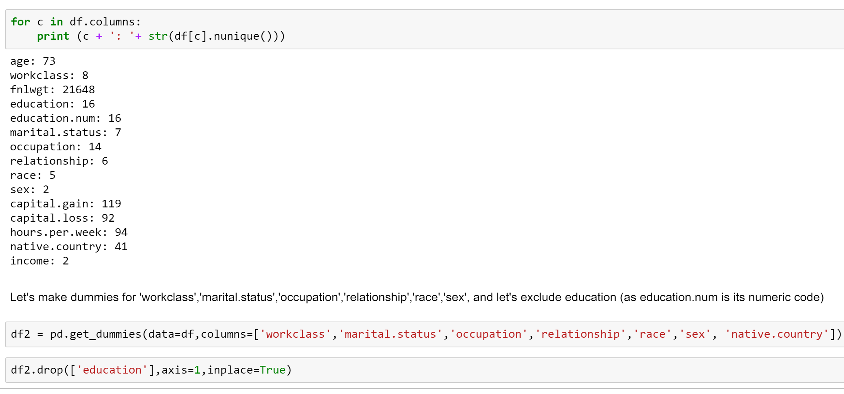
CLEANING

Slide 29
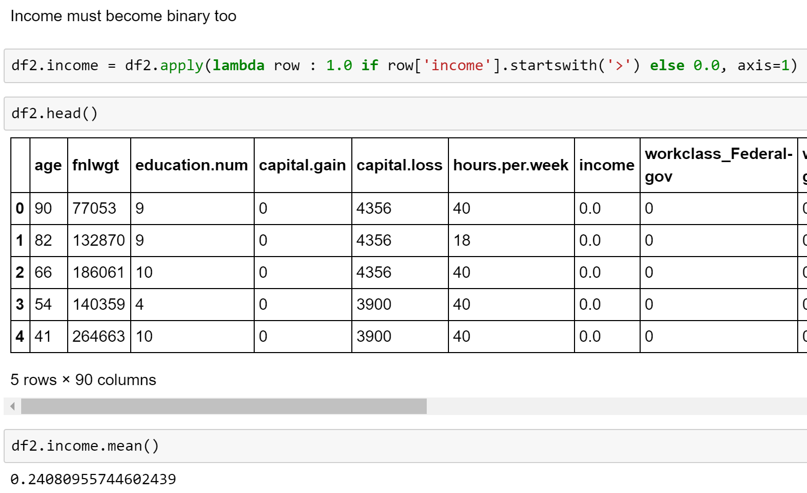
CLEANING

Slide 30
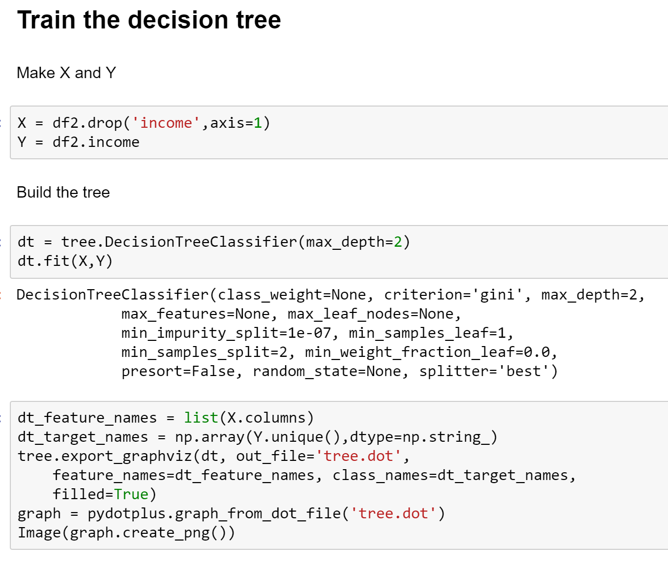
TRAIN THE DECISION TREE

Slide 31
Interpreting the Tree
The splitting rule
(if this attribute <= 0.5, go to the left child; else go to the right child)

Slide 32
Interpreting the Tree
The “diversity” of the population in this node. The tree is built to minimize diversity in its leaves

Slide 33
Interpreting the Tree
How many objects of the training set fall into this node

Slide 34
Interpreting the Tree
How many belong to class 0 and how many to class 1

Slide 35
Interpreting the Tree
The predicted class if this was a leaf

Slide 36
Those not married civilly and with low capital gain have low income

Slide 37
Those not married civilly and with high capital gain have high income

Slide 38
Those married civilly and with low education have low income

Slide 39
Those married civilly and with high education have high income

Slide 40
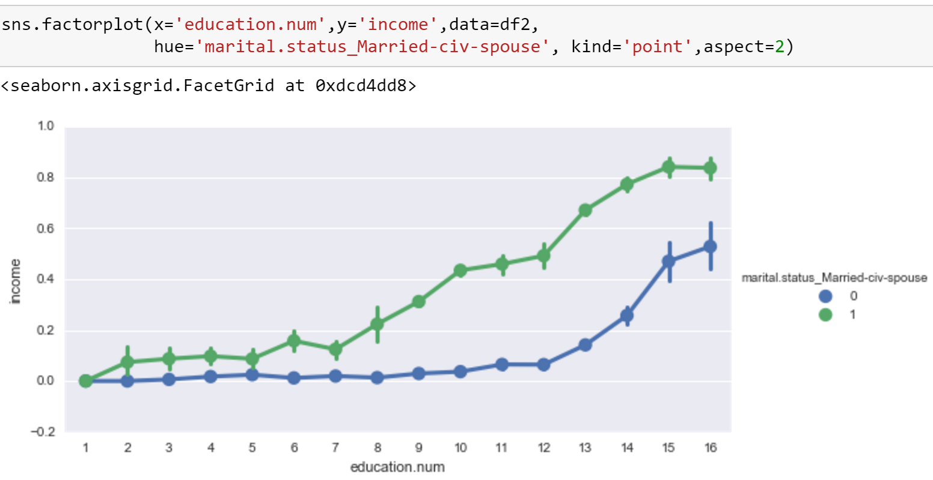
Education.num = 12.5 is a good threshold to separate low income from high income, but it is more effective for those married civilly (right part of the tree)

Slide 41
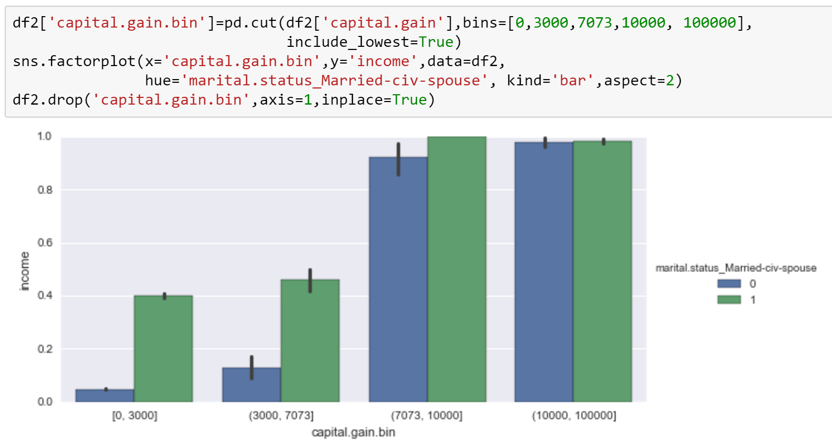
Capital.gain = 7073 is a good threshold to separate low income from high income, but it is more effective for those NOT married civilly (left part of the tree)

